Slide 1
Revision from Year 10
Nelson Chemistry Units 1&2: Chapter: 3.4, 3.6 & 4.1

Slide 2
Define the term ionic bonding.

Slide 3
Ionic compounds
Physical properties (Page:168)
Most ionic compounds:
are hard and brittle( they are not easily scratched but will shatter on impact)
are non-conductors of electricity in the solid state but are good conductors in a molten or an aqueous state
have high melting and boiling points

Slide 4
Ions are atoms or groups of atoms that are electrically charged due to an imbalance in the number of electrons and protons.
Ionic bonding is due to the electrostatic force of attraction between oppositely charged ions.

Slide 5
3.4 Names and formulas of ionic compounds
In the names and formulas of ionic compounds composed of only two elements, the positively charged ion is always listed first and the negatively charged ion is listed second.
The name of the positive ion is the same as the name of the element from which it was formed. In the name of the negative ion, the end of the non-metal parent element is replaced with –ide.
E.g. chlorine becomes chloride
Sodium chloride

Slide 6
Many Transition metals show more than one possible charge because they have slightly different electron structures from other metals.
E.g. The metal iron forms both Fe²⁺ and Fe³⁺ ions.
The one with a lower charge had –ous at the end of its name and the one with a higher charge had –ic at the end of its name.
Now there is a much easier system in which charge can be shown as a Roman numeral.

Slide 7
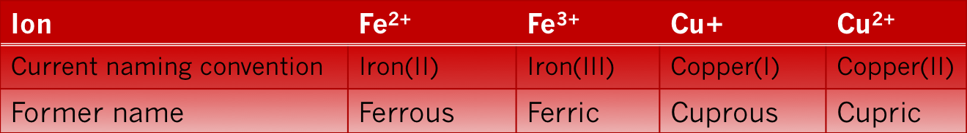
FeCl₂--------------------------------------- iron(II) chloride
FeCl₃----------------------------------------iron(III) chloride

Slide 8
In many ionic compounds, the positive ion or the negative ion ( or both) consists of two or more atoms that are strongly bonded together and act as a single entity. These ions are called polyatomic ions.
The charge on polyatomic ions is spread over the whole ion.

Slide 9
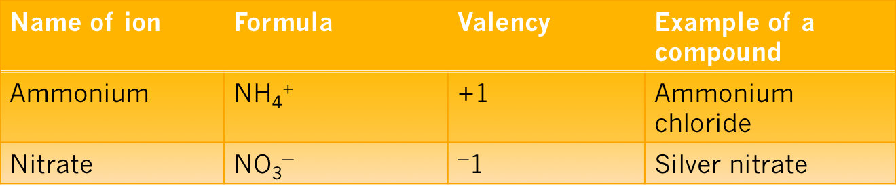
Formulas for ionic compounds
When determining formulas of ionic compounds, one simple rule: Ionic compounds have no net charge. This means the total number of positive charges equals the total number of negative charges. Therefore, you need to determine the ratio of ions that will achieve this.
Do Question set 3.4- Q’s: 1,2a, c and e, 3,4a and f , 5a,c and 6c, e and g

Slide 10
Covalent compounds
They have low melting and boiling points.
Non-conductors of electricity in solid and liquid states.
Form solids that are generally soft.
Variable solubility & reactivity.
E.g. oxygen and water
Covalent bonding: Covalent bonding is the electrostatic forces of attraction between electrons & the nucleus of more than one atom.

Slide 11
3.6 Names and formulas of covalent compounds
Naming covalent compounds
Use the element name for the first element and change the end of the name of the second element to ide;
e.g. hydrogen fluoride
The first named element is the one that is further to the left in the periodic table.
If both elements are in the same group, the one lower down the group is named first.
An exception to rules 2 and 3 is when oxygen is bonded to Cl, Br or I. In these compounds oxygen is named last.
The number of atoms of each type is given by using the prefixes in front of each part of the name. ( mono- may be omitted from the first named element)
E.g. CO- carbon monoxide, N₂O₅- dinitrogen pentoxide
Do Question Set: 3.6 – Q’s 1, 2 a and d, 3 a and d

Slide 12
4.1 Chemical reactions
Chemical reactions are important in our lives, in our homes and in industry.
Chemical reactions occur every time we light a gas stove or a barbecue.
In industry, new materials are continuously being developed- these require chemical reactions, such as WikiCell, an edible form of packaging that will significantly decrease our need for plastics.

Slide 13
Photosynthesis, respiration, rusting and combustion are all chemical reactions.
Chemical equations
A chemical reaction can be represented by a chemical equation, which can use words or formulas. In a chemical equation, reactants are written on the LHS of the arrow and the products are written on the RHS of the arrow. The single arrow always points in the direction of the reaction; i.e from the reactants to products.

Slide 14
The word equation for photosynthesis is:
Carbon dioxide + water ➔ glucose + oxygen

Slide 15
Balancing chemical equations
Chemists represent chemical reactions by using chemical symbols and formulas for the reactants and products.
The numbers are written in front of chemical formulas to balance the equation so that there is the same number of atoms of each element on each side.
number ‘1’ is not written because it is assumed when no other number appears before the formula.
Generally, equations are written as the lowest whole number ratio between reactants and products. This ensures that the law of conservation of mass is maintained.
Law of conservation of mass states that in a chemical reaction, mass is neither created nor destroyed. The total mass of products equals the total mass of the reactants.

Slide 16
The states for each of the reactants and products are included: (s) for solid, (l) for liquid, (g) for gas and (aq) for aqueous solution.
In some sources, (aq) is not included; if a reactant or product does not have a state included, it is assumed that it is an aqueous solution (dissolved in water).
Do question set: 4.1 ( Q’s 1,2, 3( a,c) 4 ( b, c)
and 5a
Do set: 13 - Compounds and formulae: Text- Exploring
Chemistry -Year-11(Page: 138) (Questions: 1(a,d,f), 2( b, f, i), 3 ( a, c, j) and 4( a, d, j)

